Slide 1


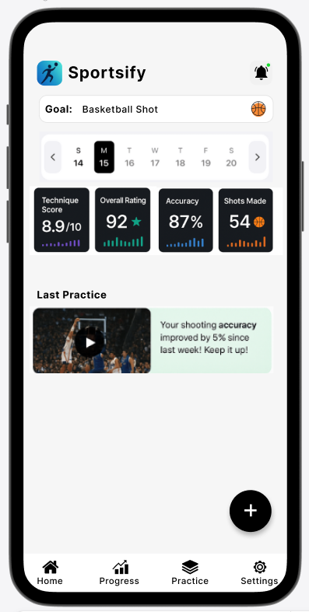
Sportify
Image
App Logo
Group 2: Max, Fadi, Ken, Habib
CSI 2999: Sophomore Project
Group Project – Fall 2025
School of Engineering and Computer Science
Oakland University
Instructor: Dr. Hadeel M. Jawad
Project description
Sportsify is a web application that enables users to capture video of their sports performance, receive automated technical analysis using AI models, and get personalized drills and progress tracking. The system supports any sport that can be evaluated visually (shooting form, swing mechanics, footwork, etc.) and focuses on practical, easy-to-follow corrective suggestions to accelerate skill improvement.
Application Genre/Category: Lifestyle, Coaching
Targeted Audience
Athletes
Coaches
Sports and fitness fans
Features
Source of Revenue
Camera Access button ,Upload Button, Login/Sign Up,User Timeline, Last practice video,SnapShot Display Buttons,Profile Menu, Circle Percentage Chart, Download/Share Button, Position Toggle, Practice/drill difficulty
Paid version that is a subscription with advanced tools and more detailed reports.
Team plans that allow coaches to manage their teams performance.
One time purchases: detailed report, special video analyses and etc.

